Slide 1

Session 7 – Python
Brief Intro to Machine Learning with Scikit Learn
Dataset Preparation
Doug Bowman

Slide 2
Dataset Preparation
Overview
  Train Test Split
  Cross Validation
  Scaling Data
  Converting Categories to Numbers
  Estimating Missing Values
  Checking Feature Correlation
  Manually Engineering Features

Slide 3
Dataset Preparation
Train Test Split
  Simple way to get training data and test data
  Standard 75% training, 25% test data can be tweaked
  Data by default is shuffled before splitting
  Data can be stratified

Slide 4

Dataset Preparation
In-Class Exercise
  Adjust the training and test split, and see how accuracy changes with a model of your choice:
    test_size = 20, train_size = 80
    test_size = 30, train_size = 70
    test_size = 25, train_size = 50

Slide 5
Dataset Preparation
Cross Validation
  When working with train test split, sometimes information can still be pushed back into the model and affect the test data set
    Can happen with hyperparameters

Slide 6
Dataset Preparation
Cross Validation
  One option is to split the data into 3 sets:
    Training data
    Validation data
      Now used as our new test data to tune the model
    Test data
      Used after the model is optimized for final accuracy check
  This unfortunately greatly reduces the training data set, and can decrease model effectiveness.

Slide 7
Dataset Preparation
Cross Validation
  Another option is to take multiple smaller cuts of the training data, called folds.
  With k folds, k-1 folds are used for training and one is used for validation.
  There will be k different scores, one for using each fold as the validation set once.
  The resulting score can be calculated by taking the mean score.

Slide 8
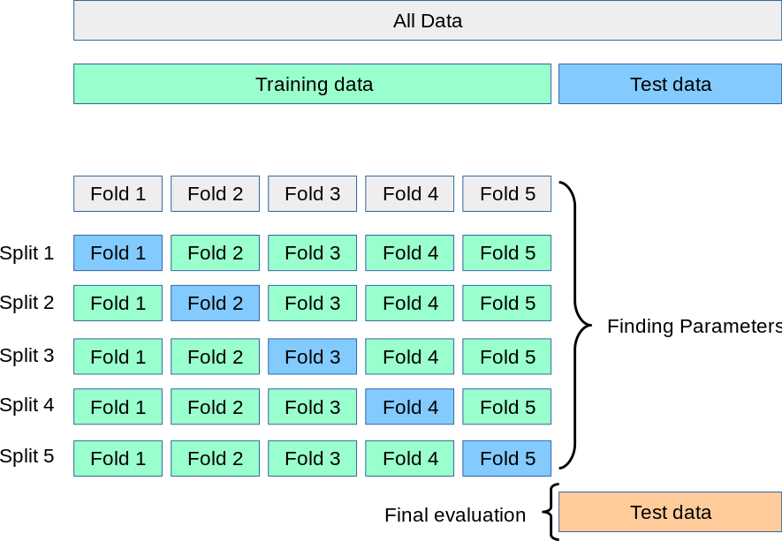
Dataset Preparation
Cross Validation
(8)

Slide 9
Dataset Preparation
In-Class Exercise
  Create a model with your choice of model and data. Using the cross_val_score method, adjust the number of folds, noting the following:
    How does the mean score change?
    How does the standard deviation change?
      Is this important?
    How does computational time change?

Slide 10
Dataset Preparation
Scaling Data
  Changing the values of the training data set in such a way to normalize, or convert the data into a specific range.
  Certain algorithms are more sensitive to data scaling:
    SVM
    K-nearest neighbors
    Logistic regression

Slide 11
Dataset Preparation
Scaling Data
  Scaling is more of an art form—there is no standard procedure that will increase accuracy for all models via scaling.

Slide 12
Dataset Preparation
Scaling Data
  Types of scalers
    Min Max Scaler (MinMaxScaler)
      Values scaled between 0 and 1
      Adversely affected by outlier values

Slide 13
Dataset Preparation
Scaling Data
  Types of scalers
    Standard Scaler (StandardScaler)
      Resulting distribution has a std dev = 1
      Resulting distribution has a variance = 1
      StandardScaler makes the mean ~ 0.
      Adversely affected by outlier values

Slide 14
Dataset Preparation
Scaling Data
  Types of scalers
    Robust Scaler (RobustScaler)
      Scales data to the interquartile range
        Interquartile range = Q3 – Q1
        Q3 is the value where 75% of the data occurs before the value, when the data is ordered.
        Q1 is the value where 25% of the data occurs before the value, when the data is ordered.
      Well suited for data sets with outliers

Slide 15
Dataset Preparation
Scaling Data
  Types of scalers
    For more scalers, and a visual comparison, see https://scikit-learn.org/stable/auto_examples/preprocessing/plot_all_scaling.html#sphx-glr-auto-examples-preprocessing-plot-all-scaling-py

Slide 16
Dataset Preparation
Scaling Data
  When scaling data, ensure both the training data and the test data are scaled.
    Test performance will plummet if it is not scaled as well.
  Ensure real-world data inputted into the model is also scaled.

Slide 17
Dataset Preparation
In-Class Exercise
  Using any chosen data set, scale model data of your choice using the 3 covered scalers:
    MinMaxScaler
    StandardScaler
    RobustScaler

Slide 18
Dataset Preparation
In-Class Exercise
  Apply each scaled set of data to a classifier and regressor data set.
    Suggest to try the scalers out on an SVM, or other sensitive classifier trainer.

Slide 19
Dataset Preparation
Converting Categories to Numbers
  Trainers understand numbers better than text. If there are a set number of text categories, converting them to numbers will help.
  If you have 5 categories, replacing them with numbers will make the model more accurate and/or more efficient.
    ‘Lake’ → 0
    ‘River’ → 1
    ‘Stream’ → 2
    ‘Ocean’ → 3
    ‘Pond’ → 4

Slide 20
Dataset Preparation
Converting Categories to Numbers
  Scikit-learn provides a transformer for this
    LabelEncoder
    Apply the encoder to each column of the data set that has categorical strings.
    Do this before splitting the data into training and testing data.

Slide 21
Dataset Preparation
Converting Categories to Numbers
  Go over in-class example using housing.csv data.

Slide 22
Dataset Preparation
In-Class Exercise
  Using the data at ‘./Session 7 - Python/Instructional Material/In-Class Exercises/Data/Inflation 1980-2020.csv’, load the data into Python and encode one of the category-based columns (such as the “LOCATION” column).

Slide 23
Dataset Preparation
Converting Categories to Numbers
  One issue with this is that some algorithms will assume numbers closer to each other will be more similar.

Slide 24
Dataset Preparation
Converting Categories to Numbers
  For example, look at the following data representing food:
    chicken → 0
    raspberries → 1
    salmon → 2
    turkey → 3
    yogurt → 4
  If we were trying to predict nutritional content of food, our model may assume chicken and raspberries are more related than chicken and turkey since the indices of chicken and raspberries are closer together.

Slide 25
Dataset Preparation
Converting Categories to Numbers
  One solution to this is to create a new feature for each numerical category, with a possible value of either 1 or 0.
    Instead of having one column that could have a value within the range [0,4], there would be 5 new columns each representing one of the values in the original column.
    Each new column will have a value of either 1 or 0
    This is called one-hot encoding.
      Scikit-Learn uses the OneHotEncoder transformer to handle this

Slide 26
Dataset Preparation
Converting Categories to Numbers
  Go over in-class example of one-hot encoding using housing.csv data.

Slide 27
Dataset Preparation
In-Class Exercise
  Using the data at ‘./Session 7 - Python/Instructional Material/In-Class Exercises/Data/Inflation 1980-2020.csv’, use the one-hot encoder to create multiple columns from one of the category-based columns (such as the “LOCATION” column).

Slide 28
Dataset Preparation
Converting Categories to Numbers
  To apply both binary encoder and one-hot encoder in one go, we can use the LabelBinarizer transformer.
  Note that for each of these methods, the output is an array of just the transformed column, not the entire data set including the new data.
    The transformed column data will need added back to the original data.

Slide 29
Dataset Preparation
Converting Categories to Numbers
  Go over in-class example of label binarizer encoding using housing.csv data.

Slide 30
Dataset Preparation
In-Class Exercise
  Using the data at ‘./Session 7 - Python/Instructional Material/In-Class Exercises/Data/Inflation 1980-2020.csv’, apply the LabelBinarizer and check the output against the sequential application of the LabelEncoding and OneHotEncoding methods in the previous exercise.
    This is more of a quick exercise to check for DataFrame and 2D array equality

Slide 31
Dataset Preparation
In-Class Exercise
  Train a model with both the string categories, and then with numerical categories.
    Does your trainer allow you to use string categorical data?
    How is accuracy affected by converting the string categories to numerical categories?
    How is the speed affected by converting the string categories to numerical categories?

Slide 32
Dataset Preparation
Estimating Missing Values
  Missing values can be interpreted as nan values (example on next slide).
  Missing values can throw off the accuracy of your model.
  Depending on the trainer, the data point may be ignored.

Slide 33
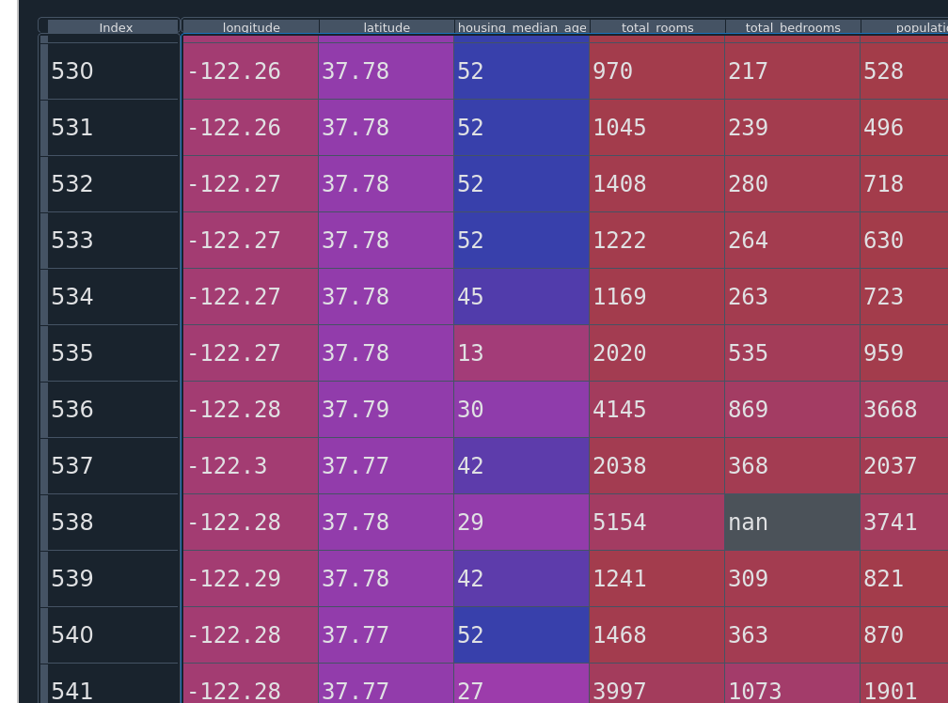
Dataset Preparation
Estimating Missing Values
Example of nan value in DataFrame shown within the data explorer of Spyder.

Slide 34
Dataset Preparation
Estimating Missing Values
  Scikit-learn utilizes the Imputer class to fill in missing data.
    In newer versions, use SimpleImputer.
  Can choose how you want missing values estimated.
    Known as the strategy.

Slide 35
Dataset Preparation
Estimating Missing Values
  Options for estimation (strategies):
    mean
    median
    most_frequent

Slide 36
Dataset Preparation
Estimating Missing Values
  Imputer only works on numerical values, not strings.
  If missing data in strings exist, they must be converted to numerical values or the columns must be removed.

Slide 37
Dataset Preparation
Estimating Missing Values
  Reminder/note: the import statement “from sklearn.preprocessing import Imputer” was deprecated with scikit-learn v0.20.4 and removed as of v0.22.2.
  Use “from sklearn.impute import SimpleImputer” instead

Slide 38
Dataset Preparation
Estimating Missing Values
  Go over Imputer example in class.

Slide 39
Dataset Preparation
In-Class Exercise
  For each column that has nan values, convert them to an estimated value using an imputer.
    Use any strategy you wish.
  Train a machine learning model with the imputed data.
    Remember how the model assumes correlations for numbers that are close together.

Slide 40
Dataset Preparation
Checking Feature Correlation
  We can check how closely correlated two features are with each other.
    One reason is to see how much changing one feature will affect another
      Such as a feature vs the collected target values.
    Another reason might be in deciding whether certain features can be removed from the data.
    Another reason might be in deciding how useful an engineered feature is.

Slide 41
Dataset Preparation
Checking Feature Correlation
  Use the .corr() method of a pandas DataFrame
    Creates a correlation matrix, showing correlations between each feature with all other features.
    Same as Pearson’s R correlation.
    Only for linear correlations.

Slide 42
Dataset Preparation
Checking Feature Correlation
  Use the .corr() method of a pandas DataFrame
    Ranges from [-1,1]
    Closer to 0 means the feature has less affect.
    Closer to 1 means increasing the feature increases the prediction, decreasing the feature decreases the prediction.
    Closer to -1 means increasing the feature decreases the prediction value, and vice versa.

Slide 43
Dataset Preparation
Checking Feature Correlation
  Go over Pandas DataFrame.corr() method in-class example.

Slide 44
Dataset Preparation
Checking Feature Correlation
  scipy Correlation Functions
    Pearson’s R Correlation
      Returns two values
        R value, as with the DataFrame.corr()
        Two-tailed p-value (see citation 11)
      For linear correlations
      Assumes normal distribution between features
      scipy.stats.pearsonr(iterable_1, iterable_2)
      Will not show non-linear correlations

Slide 45
Dataset Preparation
Checking Feature Correlation
  P-value
    “In statistics, the p-value is the probability of obtaining results at least as extreme as the observed results of a statistical hypothesis test, assuming that the null hypothesis is correct. The p-value serves as an alternative to rejection points to provide the smallest level of significance at which the null hypothesis would be rejected. A smaller p-value means that there is stronger evidence in favor of the alternative hypothesis. “ ^{[13]}

Slide 46
Dataset Preparation
Checking Feature Correlation
  P-value
    P-value compares the correlation factor of the data set used with that of an uncorrelated data set
    It is the probability that a random sample from the uncorrelated data set will have a correlation coefficient at least as great as that of the desired data set.

Slide 47
Dataset Preparation
Checking Feature Correlation
  P-value
    Another description is the p-value represents running an experiment that the data set chosen is not correlated.
    The smaller the p-value, the more correlated the data set is.

Slide 48
Dataset Preparation
Checking Feature Correlation
  scipy Correlation Functions
    Spearman’s Correlation
      Returns two values:
        Correlation value
        P-value “hypothesis test whose null hypotheisis is that two sets of data are uncorrelated.” (see citation 12)

Slide 49
Dataset Preparation
Checking Feature Correlation
  scipy Correlation Functions
    Spearman’s Correlation
      For non-linear correlations
      Does not assume features are normally distributed
      scipy.stats.spearmanr(iterable_1, iterable_2)
      Will also show linear correlations, but the magnitude will not be as high as with Pearson’s

Slide 50
Dataset Preparation
Checking Feature Correlation
  Remember that before splitting the data, the targets and training data are all in the same data structure.
  Can test the data correlation with the soon-to-be target column while everything is in the same structure.

Slide 51
Dataset Preparation
Checking Feature Correlation
  Go over SciPy correlation methods in-class example.

Slide 52
Dataset Preparation
In-Class Exercise
  Using data of your choice, show correlation factors using each method:
    DataFrame.corr()
    Pearson’s R (from SciPy)
    Spearman’s Correlation (from SciPy)

Slide 53
Dataset Preparation
Checking Feature Correlation
  Feature Importances
    With some machine learning models, we can check the feature_importances_ property.
    Decision trees have this property, as well as ensemble methods.
    Can call property once the model has been taught.

Slide 54
Dataset Preparation
Checking Feature Correlation
  Go over feature importance in-class example.

Slide 55
Dataset Preparation
In-Class Exercise
  Using the data from the previous exercise (or of your choice), train a model and show the feature importances.

Slide 56
Dataset Preparation
Dimensionality Reduction
  This concept reduces the number of dimensions in a data set
  Issues resolved
    Slow computation due to size
    Memory limitations
    Sometimes hard disk size limitations
    Curse of dimensionality

Slide 57
Dataset Preparation
Dimensionality Reduction
  Slow computation due to size
    The more features we have, the more computational power we need to train and run machine learning algorithms.
    Less dimensions means less CPU power needed

Slide 58
Dataset Preparation
Dimensionality Reduction
  Memory limitations
    More features means more memory is used to train and utilize machine learning algorithms.
    Very large datasets may not fit into memory.

Slide 59
Dataset Preparation
Dimensionality Reduction
  Hard Disk Space Limitations
    Just like with memory, we can sometimes run into hard disk space issues if too many features are utilized.
      This is much more unlikely than memory issues.

Slide 60
Dataset Preparation
Dimensionality Reduction
  Downside
    You are reducing a dimension, so there will be some data loss versus the original data set.

Slide 61
Dataset Preparation
Dimensionality Reduction
  Curse of Dimensionality
    The more dimensions you have, the more likely the dataset is to be sparse.
    The sparser the dataset, the further away each data point is from another one.

Slide 62
Dataset Preparation
Dimensionality Reduction
  Curse of Dimensionality
    Because of this, larger-featured datasets are at greater risk of being over-fitted due to ML algorithms needing to extrapolate more to fit the data.
      The algorithm doesn’t get enough data points close together to get a good idea of how to estimate data at a given point.

Slide 63
Dataset Preparation
Dimensionality Reduction
  Curse of Dimensionality
    For example, let’s say you want to estimate trees based on pictures.
    If you were to estimate only based on bark, how many pictures would you need?

Slide 64
Dataset Preparation
Dimensionality Reduction
  Curse of Dimensionality
    If you were to estimate based on bark, leaf shape, leaf color, leaf arrangement, and hardiness zones, how many pictures would you need?

Slide 65
Dataset Preparation
Dimensionality Reduction
  Curse of Dimensionality
    Very simplified counts below:
    Bark possibilities: 7
    Leaf shape possibilities: 6
    Leaf color possibilities: 4
    Leaf arrangement possibilities: 9
    Hardiness zone possibilities: 8

Slide 66
Dataset Preparation
Dimensionality Reduction
  Curse of Dimensionality
    With each new feature, we have more than one additional possible outcome.
      Exponential increase in data point possibilities.
      Exponential increase in required data points to fully constrain data.
    And this is just as it applies to a classification problem.

Slide 67
Dataset Preparation
Dimensionality Reduction
  Two types:
    Projection
    Manifold

Slide 68
Dataset Preparation
Dimensionality Reduction
  Projection
    Finding the points of a data set on a lower dimensional hyperplane.
      Taking the “shadow” of the points on a lower dimension hyperplane.
    Effective when the points of an N dimensional data set lie close to an N-1 dimensional hyperplane.

Slide 69
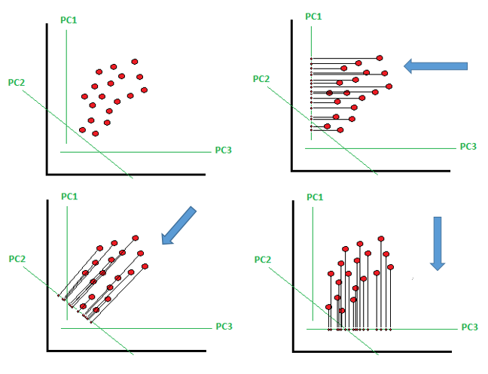
Dataset Preparation
Dimensionality Reduction
  Projection
[17]

Slide 70
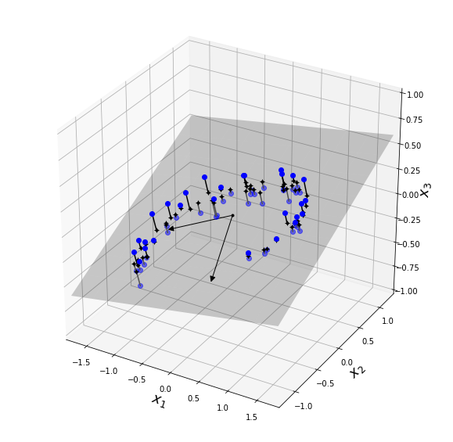
Dataset Preparation
Dimensionality Reduction
  Projection
[16]

Slide 71
Dataset Preparation
Dimensionality Reduction
  Projection
    In theory, there are an unlimited number of lower-dimensional hyperplanes we can project on to.
    In general, we want to pick the lower-dimensional hyperplane such that variance is maximized.

Slide 72
Dataset Preparation
Dimensionality Reduction
  Projection
    The larger the variance, the less information we will lose (with respect to the original data set).
    The larger the variance, the more variety of data we keep for the ML algorithm to learn from.

Slide 73
Dataset Preparation
Dimensionality Reduction
  Projection Algorithms
    Principal Component Analysis (PCA)
      Reduces the data set down to δ dimensions.
      Finds δ axes of the largest variance, ordered descending.
        These are known as the principal components.
        Each principal component is orthogonal (90°) to the others.

Slide 74
Dataset Preparation
Dimensionality Reduction
  Projection Algorithms
    Principal Component Analysis (PCA)
      Transforms the data set by projecting each data point onto these δ dimensions.
      Principal components are not guaranteed to be the same in subsequent executions of the algorithm.

Slide 75
Dataset Preparation
Dimensionality Reduction
  Projection Algorithms
    Principal Component Analysis (PCA)
      As a starting guideline, choose the number of δ principal components to maintain 95% of the variance.
      Note that scaling is important before applying PCA if the features span multiple orders of magnitude.

Slide 76
Dataset Preparation
Dimensionality Reduction
  Projection Algorithms
    Principal Component Analysis (PCA)
      Also note that this just transforms the data in preparation for a ML algorithm.

Slide 77
Dataset Preparation
Dimensionality Reduction
  Projection Algorithms
    Go over in-class example of principal component analysis.

Slide 78
Dataset Preparation
In-Class Exercise
  Using the data from the previous exercise (or of your choice), train a model using PCA-transformed data.
    Create the PCA object
    Transform and fit the data
    Feed to ML algorithm
    Check accuracy

Slide 79
Dataset Preparation
Dimensionality Reduction
  Projection Algorithms
    Incremental Principal Component Analysis
      Splits the dataset into smaller batches, feeding the algorithm one batch at a time.

Slide 80
Dataset Preparation
Dimensionality Reduction
  Projection Algorithms
    Incremental Principal Component Analysis
      Will reduce the computational cost of performing PCA.
      If data is too large for operations after PCA, will need to run machine learning models that also incorporate partial fit for each batch.

Slide 81
Dataset Preparation
Dimensionality Reduction
  Projection Algorithms
    Incremental Principal Component Analysis
      Useful when we can’t fit the entire dataset in memory.
      Useful if we are training online.
        Using in a system constantly receiving new data

Slide 82
Dataset Preparation
Dimensionality Reduction
  Projection Algorithms
    Incremental Principal Component Analysis
      Uses partial_fit() vs fit()

Slide 83
Dataset Preparation
Dimensionality Reduction
  Projection Algorithms
    Go over in-class example of incremental principal component analysis.

Slide 84
Dataset Preparation
In-Class Exercise
  Using data of your choice, train a model using data transformed from incremental PCA.
    Create the IncrementalPCA object
    Transform and fit the data
    Feed to ML algorithm
    Check accuracy

Slide 85
Dataset Preparation
Dimensionality Reduction
  Projection Algorithms
    Randomized Principal Component Analysis
      Quick approximation that is much faster than PCA when the number of principal components (δ) is much smaller than the features in the original dataset (n).

Slide 86
Dataset Preparation
Dimensionality Reduction
  Projection Algorithms
    Go over in-class example of randomized principal component analysis.

Slide 87
Dataset Preparation
In-Class Exercise
  Using data of your choice, train a model using data transformed from randomized PCA.
    Create the PCA object
    Transform and fit the data
    Feed to ML algorithm
    Compare accuracy between the randomized PCA and normal PCA
    Optionally, compare execution time

Slide 88
Dataset Preparation
Dimensionality Reduction
  Projection Algorithms
    Kernel Principal Component Analysis
      Similar to kernel trick in the support vector machines.
      Review kernel trick and gamma hyperparameter in SVM section (slide 83).

Slide 89
Dataset Preparation
Dimensionality Reduction
  Projection Algorithms
    Kernel Principal Component Analysis
      Add feature(s) to get into a higher dimension space, then use kernel trick to get projection back on to lower dimensional space.

Slide 90
Dataset Preparation
Dimensionality Reduction
  Projection Algorithms
    Kernel Principal Component Analysis
      Mathematically, we can calculate the components of PCA by performing vector dot products in a higher space.
      The dot product of vectors is the same as a projection onto a lower dimensional space.

Slide 91
Dataset Preparation
Dimensionality Reduction
  Projection Algorithms
    Kernel Principal Component Analysis
      Pros
        Computationally cheaper than calculating the components using normal PCA.
        Good at preserving clusters of data.
        Can sometimes unroll data in a manifold.

Slide 92
Dataset Preparation
Dimensionality Reduction
  Projection Algorithms
    Kernel Principal Component Analysis
      Cons
        Error is introduced into the data.

Slide 93
Dataset Preparation
Dimensionality Reduction
  Projection Algorithms
    Kernel Principal Component Analysis
      Cons
        With normal PCA, we can perfectly transform the PCA data set back to the original data set if we maintain the same number of components.
        This is not true with kernel PCA.

Slide 94
Dataset Preparation
Dimensionality Reduction
  Projection Algorithms
    Kernel Principal Component Analysis
      Use a kernel functions to perform the dot product operation.
      Kernel function gives the dot product of the vectors into a higher dimensional feature space ^{[18]}.
      Not every function is a kernel function.

Slide 95
Dataset Preparation
Dimensionality Reduction
  Projection Algorithms
    Kernel Principal Component Analysis
      Go over in-class example.

Slide 96
Dataset Preparation
In-Class Exercise
  Using data of your choice, train a model using data transformed from kernel PCA.
    Create the PCA object
    Transform and fit the data
    Feed to ML algorithm
    Try different kernels
      rbf
      sigmoid
      Poly (don’t forget the “degree” argument when using this one)

Slide 97
Dataset Preparation
Dimensionality Reduction
  Manifold
    An (N-1)-dimensional object that is contorted in an N-dimensional space.
    A 2-D manifold would be a 2-dimensional shape in an N-dimensional space.

Slide 98
Dataset Preparation
Dimensionality Reduction
  Manifold
    Manifold assumption – most real-world, high-dimension data sets lie close to a much lower-dimensional manifold.
      Needs to be empirically confirmed.

Slide 99
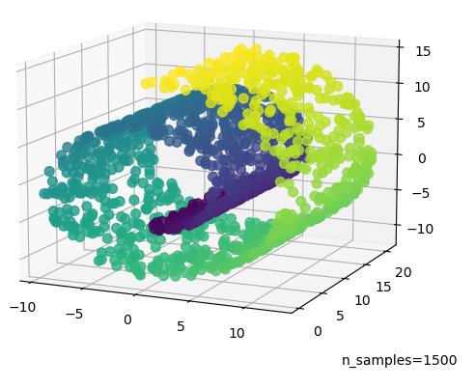
Dataset Preparation
Dimensionality Reduction
  Manifold
[14]

Slide 100
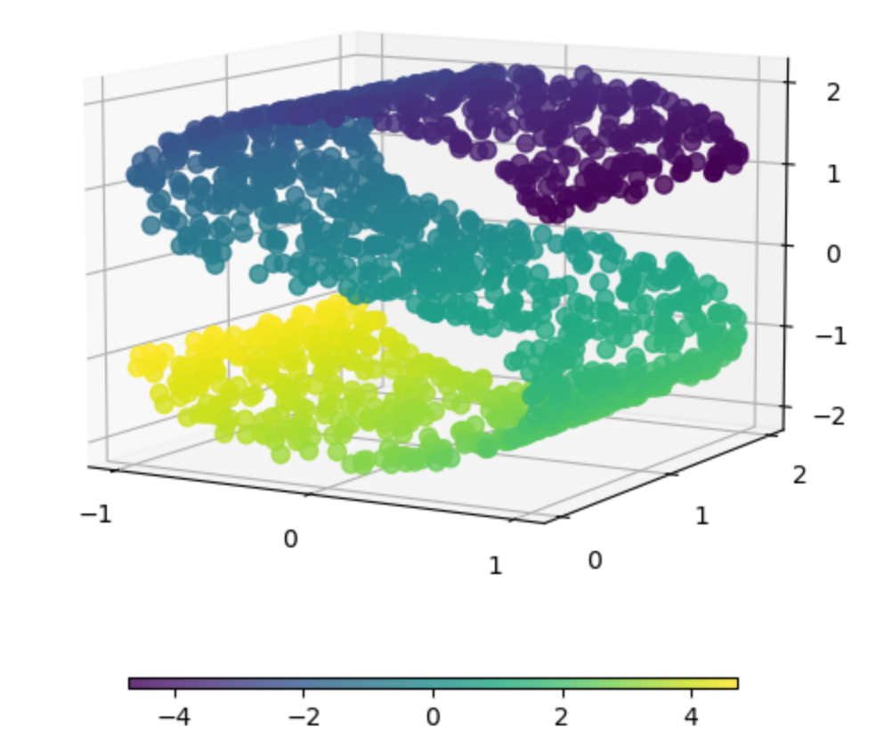
Dataset Preparation
Dimensionality Reduction
  Manifold
[15]

Slide 101
Dataset Preparation
Dimensionality Reduction
  Manifold Algorithms
    Locally Linear Embedding (LLE)
      Use k closest neighbors to reconstruct a linear version of the current data sample, x.
        Determine weights that minimizes square distance between data sample x, and the linearized variant of x (called xL)

Slide 102
Dataset Preparation
Dimensionality Reduction
  Manifold Algorithms
    Locally Linear Embedding (LLE)
      Minimize the following:
      xi is the current data sample out of m total samples
      xj is one of the other data points
      wi,j is the weight for the jth data point while trying to estimate the ith point (0 if not one of the closest neighbors.

Slide 103
Dataset Preparation
Dimensionality Reduction
  Manifold Algorithms
    Locally Linear Embedding (LLE)
      Then, the training instances x are mapped onto a lower-dimensional space, attempting to preserve the relationships between all x’s and their k closest neighbors as much as possible.

Slide 104
Dataset Preparation
Dimensionality Reduction
  Manifold Algorithms
    Locally Linear Embedding (LLE)
      While keeping the pre-determined weights fixed, find the optimal positions of x in the new space.

Slide 105
Dataset Preparation
Dimensionality Reduction
  Manifold Algorithms
    Locally Linear Embedding (LLE)
      Z is the matrix of all mapped points
      zi is the new ith data point
      zj is the new neighbor
      wi,j are the weights calculated from the original space

Slide 106
Dataset Preparation
Dimensionality Reduction
  Manifold Algorithms
    Go over in-class example.

Slide 107
Dataset Preparation
In-Class Exercise
  Apply LLE on a dataset of your choice, then send the data to a machine learning trainer of your choice..
    How does the end result compare with a ML trainer without using LLE?
    If LLE did not help the score, why did it not?

Slide 108
Dataset Preparation
Manually Engineering Features
  Create new features based on existing features.
  Look for meaningful relationships in the data, such as ratios.
  Use correlation coefficients to determine if the new features are useful or not.

Slide 109
Dataset Preparation
Manually Engineering Features
  Examples:
    In housing data, maybe the number of bedrooms/number of total rooms will be a better feature.
    In stock data, maybe the stock price/company earnings ratio is more meaningful than the price of the stock alone when determining if a stock is a bargain to buy or not.

Slide 110
Dataset Preparation
Manually Engineering Features
  Examples:
    Maybe comparing a value to the max, min, median, average, etc of all values will give a more useful feature.

Slide 111
Dataset Preparation
Section Summary
  Scaling Data
    Standard
    Robust
    Min-Max
  Correlation Coefficients
    Pearson’s R Value
    Spearman’s R Value

Slide 112
Dataset Preparation
Section Summary
  Converting String Categories
    Converting strings to numbers
      Label Encoding
    Creating a separate column for each number
      One Hot Encoding
      Label Binarizer for an all-in-one approach

Slide 113
Dataset Preparation
Section Summary
  Dimensionality Reduction
    Principal Component Analysis
      Projection data
      Types
        Normal
        Incremental
        Random
        Kernel

Slide 114
Dataset Preparation
Section Summary
  Dimensionality Reduction
    Locally Linear Embedding
      Useful for data close to a manifold

Slide 115
Dataset Preparation
Section Summary
  Manual Feature Engineering
    Look for meaningful relationships/factors in the data to create new features from

Slide 116
Dataset Preparation
In-Class Exercise
  Apply each of the following steps, checking the accuracy after each step is applied:
    Cross validation instead of train test split
    Scale the data
    Convert any string categories to numbers
    Remove weak features using correlation coefficients
    Apply any technique from Principle Component Analysis, or LLE, to find most impacting features.
    How does the end result with PCA/LLE compare to the initial accuracy without it?

Slide 117

Bibliography
https://github.com/amueller/introduction_to_ml_with_python/blob/master/02-supervised-learning.ipynb
Müller, A. C., & Guido, S. (2016). Introduction to Machine Learning with Python: A Guide for Data Scientists (1st ed.). O’Reilly Media.
http://rasbt.github.io/mlxtend/user_guide/general_concepts/gradient-optimization/

Slide 118
Bibliography
https://github.com/ageron/handson-ml
Géron Aurélien. Hands-on Machine Learning with Scikit-Learn and Tensorflow. 1st ed., O'Reilly, 2017.
https://machinelearningmastery.com/how-to-use-correlation-to-understand-the-relationship-between-variables/

Slide 119
Bibliography
Harrison, Matt. Machine Learning Pocket Reference: Working with Structured Data in Python. 1st ed., O'Reilly, 2019.
https://scikit-learn.org/stable/modules/cross_validation.html
Scikit-learn: Machine Learning in Python, Pedregosa et al., JMLR 12, pp. 2825-2830, 2011.

Slide 120
Bibliography
API design for machine learning software: experiences from the scikit-learn project, Buitinck et al., 2013.
https://docs.scipy.org/doc/scipy/reference/generated/scipy.stats.pearsonr.html
https://docs.scipy.org/doc/scipy/reference/generated/scipy.stats.spearmanr.html#scipy.stats.spearmanr

Slide 121
Bibliography
https://www.investopedia.com/terms/p/p-value.asp
https://scikit-learn.org/stable/auto_examples/manifold/plot_swissroll.html#sphx-glr-auto-examples-manifold-plot-swissroll-py
https://scikit-learn.org/stable/auto_examples/manifold/plot_compare_methods.html#sphx-glr-auto-examples-manifold-plot-compare-methods-py

Slide 122
Bibliography
16) https://wizardforcel.gitbooks.io/scikit-and-tensorflow-workbooks-bjpcjp/content/ch08-dimensionality-reduction.html
17) https://pub.towardsai.net/principal-component-analysis-in-dimensionality-reduction-with-python-1a613006d531
18) https://towardsdatascience.com/the-kernel-trick-c98cdbcaeb3f

Slide 123
Bibliography
19) https://cs.nyu.edu/~roweis/lle/papers/lleintro.pdf
20)https://docs.python.org/3/library/json.html
21)https://academic.oup.com/bioinformatics/article/24/18/2010/190849?login=false
22)https://arxiv.org/pdf/1904.10416.pdf
23)

Slide 124
Additional Resources
https://towardsdatascience.com/over-fitting-and-regularization-64d16100f45c
https://towardsdatascience.com/scale-standardize-or-normalize-with-scikit-learn-6ccc7d176a02

Slide 125
LICENSE
Copyright 2022 Douglas Bowman
Permission is hereby granted, free of charge, to any person obtaining a copy of this software and associated documentation files (the "Software"), to deal in the Software without restriction, including without limitation the rights to use, copy, modify, merge, publish, distribute, sublicense, and/or sell copies of the Software, and to permit persons to whom the Software is furnished to do so, subject to the following conditions:
The above copyright notice and this permission notice shall be included in all copies or substantial portions of the Software.
THE SOFTWARE IS PROVIDED "AS IS", WITHOUT WARRANTY OF ANY KIND, EXPRESS OR IMPLIED, INCLUDING BUT NOT LIMITED TO THE WARRANTIES OF MERCHANTABILITY, FITNESS FOR A PARTICULAR PURPOSE AND NONINFRINGEMENT. IN NO EVENT SHALL THE AUTHORS OR COPYRIGHT HOLDERS BE LIABLE FOR ANY CLAIM, DAMAGES OR OTHER LIABILITY, WHETHER IN AN ACTION OF CONTRACT, TORT OR OTHERWISE, ARISING FROM, OUT OF OR IN CONNECTION WITH THE SOFTWARE OR THE USE OR OTHER DEALINGS IN THE SOFTWARE.

